Slide 1
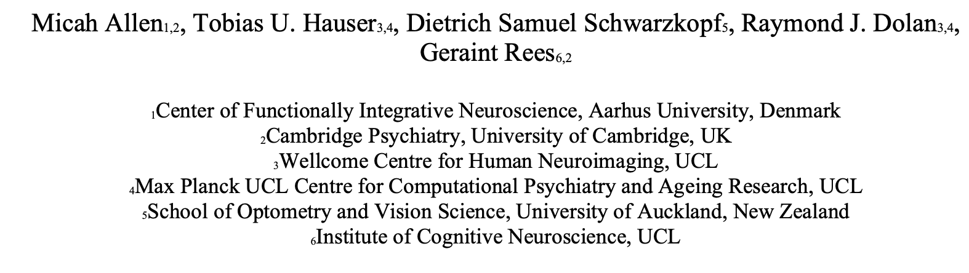
Uncertain Precision:
Neurobiological and Physiological Correlates of Conservative Confidence Bias
臧仲尧
2022.10.27

Slide 2
Introduction
Correctly estimating the influence of uncertainty on our decisions is a critical metacognitive (元认知，对认知的认知，包含对认知过程的评价和监控等)faculty.
However, the relationship between sensory uncertainty (or its inverse, precision), decision accuracy, and subjective confidence is currently unclear.
For example, one early investigation found that confidence is insensitive to reductions in sensory precision, leading to over-confident orientation discrimination (Zylberberg et al., 2014).
（有的研究认为感觉精度不会影响自信心）
In the domain of motion perception, under-confidence in response to reduced precision has also been demonstrated (Allen et al., 2016; Spence et al., 2016; Boldt et al., 2017), and substantial inter-individual differences in the impact of sensory precision on confidence have been reported (de Gardelle and Mamassian, 2015).
(有的研究认为感觉精度的降低也会引起自信心的降低，并且有很大个体差异)
Notes:
同时收的Motor execution和motor imagery任务，拿来做localizer

Slide 3
Introduction
Collectively these studies suggest that individuals display idiosyncratic precision-related confidence biases (PRCBs);
However, extant limitations preclude understanding the exact genesis and direction of these biases.
A crucial limitation is that sensory precision is typically confounded with other experimental factors, such as signal intensity and/or task difficulty, both of which can potentially impact confidence.
——实验1+实验2 把这些因素控制好后，看看想研究的现象还存不存在。
Global dot-motion task
Staircase
Notes:
同时收的Motor execution和motor imagery任务，拿来做localizer

Slide 4
Introduction
As previous experiments suggest that PRCBs may be driven in part by changes in physiological arousal (Allen et al., 2016; Hauser et al., 2017a), we hypothesized that precision-specific changes in confidence would correlate with changes in pupil dilation, an index noradrenergic arousal when luminance and task difficulty are controlled.
——实验3 看看PRCBs是否与瞳孔的扩张或收缩有关？(Physiological)
In the brain, metacognitive ability (i.e., the correspondence between confidence and accuracy) is linked to individual differences in the anatomy and microstructure of the prefrontal cortex (Fleming et al., 2010; McCurdy et al., 2013; Allen et al., 2017b). However, the specific influence of sensory precision on confidence has been linked to superior parietal and ventral striatal activations (Bang and Fleming, 2018). We thus used whole-brain regression modelling to identify cortical areas whose gray-matter volume correlated with PRCBs.
——实验4 看看PRCBs与哪些脑区的结构有关？(VBM分析, Neurobiological)
Notes:
同时收的Motor execution和motor imagery任务，拿来做localizer

Slide 5
Experiment1——感觉强度和感觉精度是否单独影响准确率和信心？ 是否有PRCB？
Notes:
同时收的Motor execution和motor imagery任务，拿来做localizer

Slide 6
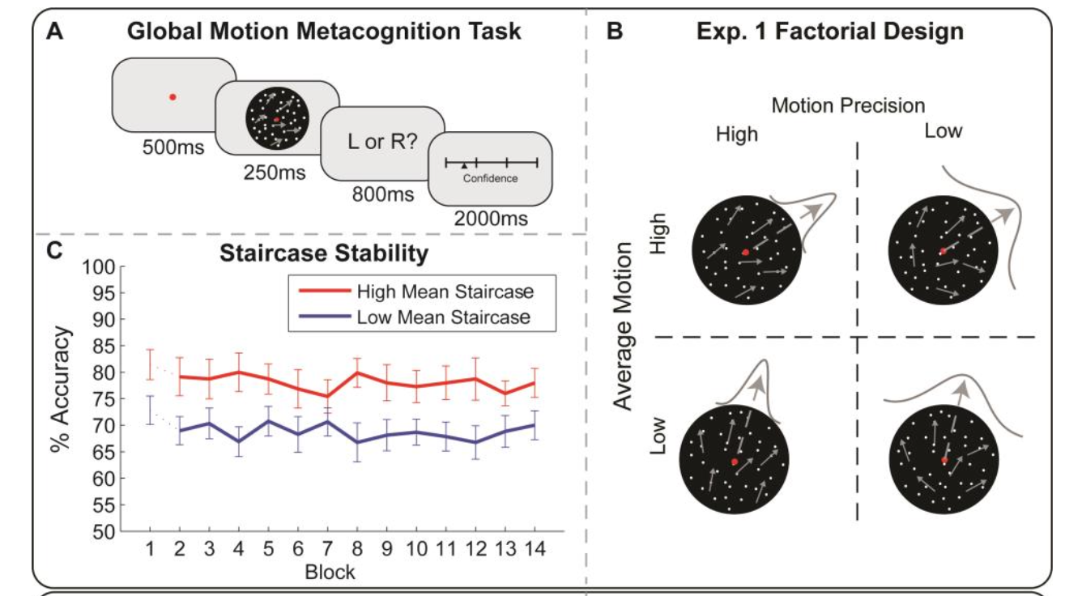
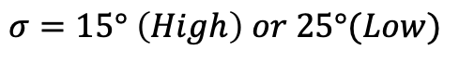
Exp1:Methods
Participants : 29 (17 female, mean age =23y, Range = 18-40)
Two independent factors:
Average Motion
(mean orientation---intensity) :
Two staircase
(High 4-down 1-up/
Low 2-down 1-up)
Motion Precision:
Dependent :
ACC, RT, Confidence
Training : 100~200 trails
Formal: 14 Blocks * 56 Trails
$$σ=15° \left(High\right) or 25°(Low)$$
Notes:
同时收的Motor execution和motor imagery任务，拿来做localizer

Slide 7
Exp1:Methods
To ensure orthogonal manipulation of signal mean and precision, responses to low precision trials were not included in the staircase. Instead, on each low precision trial, orientation was generated using the signal mean from the previous low(high?) precision trial of the same (low or high) mean staircase condition.
(低精度试次的反应不会用于调整均值，低精度试次的均值与上一个同均值水平低<高？>精度试次的相等)
For example, on each low mean (71% accuracy staircase), low precision trial, the stimulus mean was drawn from the previous low mean, high precision trial; similarly, for each high mean (85% accuracy staircase), low precision trial the stimulus mean was drawn from the previous high mean, high precision trial.
低平均、低精度试次的均值=上一低平均、高精度试次的均值；
高平均、低精度试次的均值=上一高平均、高精度试次的均值。
Notes:
同时收的Motor execution和motor imagery任务，拿来做localizer

Slide 8
Exp1:Methods
This resulted in a fully orthogonal 2 by 2 factorial design with conditions:
low mean low precision (LMLP, signal μ = 3.54°, SD = 0.82°, signal precision σ = 25°),
high mean low precision (HMLP, signal μ = 5.73°, SD = 2.04°, signal precision σ = 25°),
low mean high precision (LMHP, signal μ = 3.57°, SD = 0.86°, signal precision σ = 15°),
high mean high precision (HMHP, signal μ = 5.73°, SD = 2.04°, signal precision σ = 15°).
Boxplot inspection identified four participants for whom staircases failed to stabilize. These participants were removed from all subsequent analyses leaving a final N = 25.
After removing the first block of trials, repeated measures ANOVA (factors: sensory mean, sensory precision, block) revealed good staircase stability, with no overall effect of block on detection accuracy, F(12, 24) = 0.421, p = 0.96, and no block by condition interactions (all p > 0.16).
P=0.33
Notes:
同时收的Motor execution和motor imagery任务，拿来做localizer

Slide 9
Exp1:Analysis and Result
1.Signal Detection Theoretic Analyses of Perceptual and Metacognitive Performance
To quantify both type-I (perceptual) and type-II (metacognitive) performance, we applied a signal detection theoretic (SDT) approach.
To do so, we first binned confidence ratings into four equal quartiles, normalizing differences in the distribution of the confidence reports.
We then fit a meta-dprime (meta-d’) model to detection accuracy and binned confidence reports, to estimate the SDT parameters d’ (perceptual sensitivity), c (perceptual criterion or bias), meta-d’ (metacognitive sensitivity), and m-ratio (metacognitive efficiency, d’/m’ ? meta-d’/d’).
Notes:
同时收的Motor execution和motor imagery任务，拿来做localizer

Slide 10
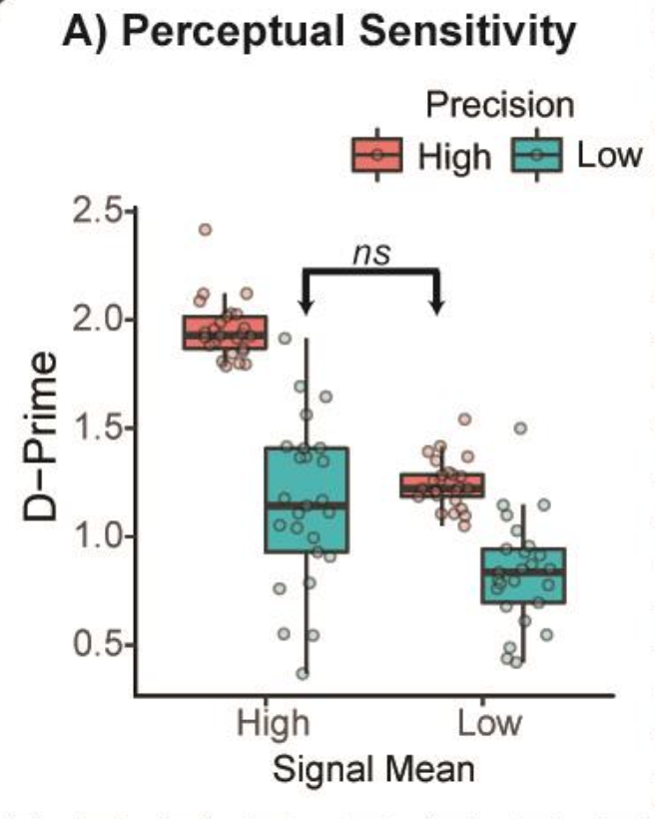
Exp1:Analysis and Result
2.Two-way Repeated ANOVA
Mean confidence, M-ratio, RT, d’, and perceptual thresholds (median orientation) were entered into separate repeated measures ANOVAs (Factors: Mean, Precision; Levels: High, Low).
For d’
Mean
F(1, 24) = 125.00, p < 0.001,
partial η2 = 0.84)
Precision
F(1,24) = 158.85, p < 0.001,
partial η2 = 0.87)
Interaction
F(1,24) = 22.07, p < 0.001,
partial η2 = 0.48
For RT
Mean
F(1, 24) = 27.84, p < 0.001,
partial η2 = 0.54
Precision
F(1,24) = 29.775, p < 0.001,
η2 = 0.56
Interaction
F(1,24) = 22.52, p < 0.001,
partial η2 = 0.48
Notes:
同时收的Motor execution和motor imagery任务，拿来做localizer

Slide 11
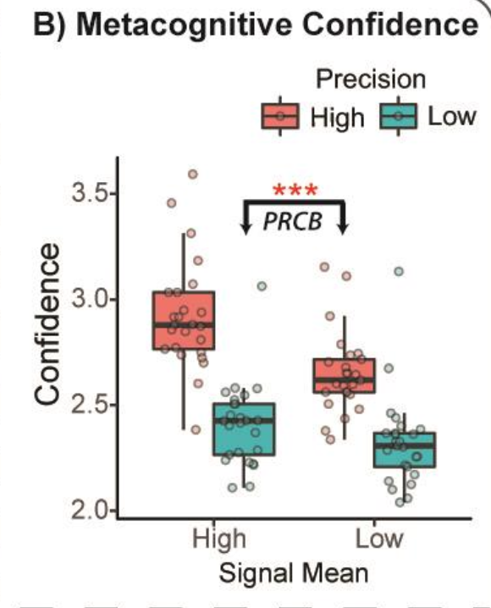


Exp1:Analysis and Result
2.Two-way Repeated ANOVA
Mean confidence, M-ratio, RT, d’, and perceptual thresholds (median orientation) were entered into separate repeated measures ANOVAs (Factors: Mean, Precision; Levels: High, Low).
For Confidence
Mean
F(1, 24) = 39.08, p < 0.001,
partial η2 = 0.62
Precision
F(1,24) = 59.39, p < 0.001,
partial η2 = 0.71
Interaction
F(1,24) = 33.25, p < 0.001,
partial η2 = 0.58
For M-ration
No significance
Indicating that perceptual mean and precision exert independent effects on confidence (type-II bias), rather than metacognitive efficiency itself.
Notes:
同时收的Motor execution和motor imagery任务，拿来做localizer

Slide 12
Exp1:Analysis and Result
3. Trial-wise Prediction of Confidence
In each experiment, to estimate the impact of sensory precision on confidence independently of perceptual difficulty, we fit regression models predicting trial-wise fluctuations in confidence while controlling for stimulus intensity (mean),reaction time, and decision accuracy(all normalised).
For each subject:
Notes:
同时收的Motor execution和motor imagery任务，拿来做localizer

Slide 13
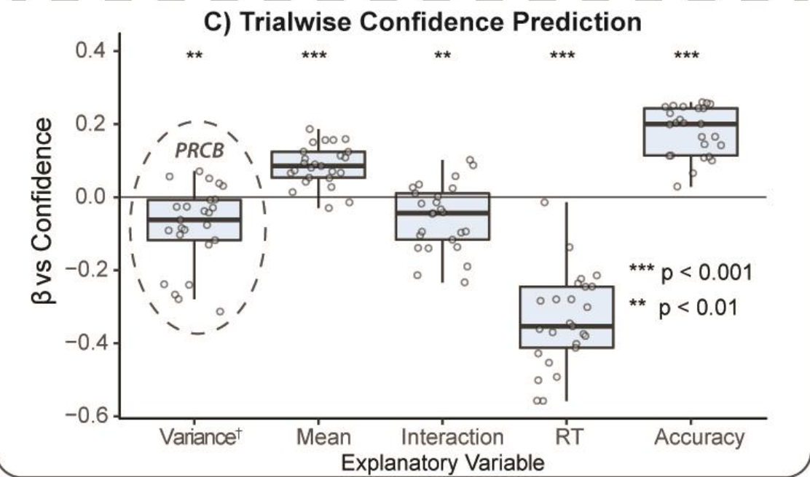
Exp1:Analysis and Result
sensory precision
t(24) = -3.66, average beta = -0.08,
p = 0.001
sensory mean
t = 7.89, p < 0.001,
interaction
(t = -3.11, p = 0.004),
accuracy
(t = -13.17, p < 0.001),
RT (t = 13.35, p < 0.001).
Notes:
同时收的Motor execution和motor imagery任务，拿来做localizer

Slide 14
Experiment1——有啥问题？
Notes:
同时收的Motor execution和motor imagery任务，拿来做localizer

Slide 15


Exp1:Analysis and Result
This resulted in a fully orthogonal 2 by 2 factorial design with conditions:
low mean low precision
(LMLP, signal μ = 3.54°, SD = 0.82°, signal precision σ = 25°),
high mean low precision
(HMLP, signal μ = 5.73°, SD = 2.04°, signal precision σ = 25°),
low mean high precision
(LMHP, signal μ = 3.57°, SD = 0.86°, signal precision σ = 15°),
high mean high precision
(HMHP, signal μ = 5.73°, SD = 2.04°, signal precision σ = 15°).
这俩没控制好难度！
Notes:
同时收的Motor execution和motor imagery任务，拿来做localizer

Slide 16
Experiment2——控制好难度，探索是否有PRCB
Notes:
同时收的Motor execution和motor imagery任务，拿来做localizer

Slide 17
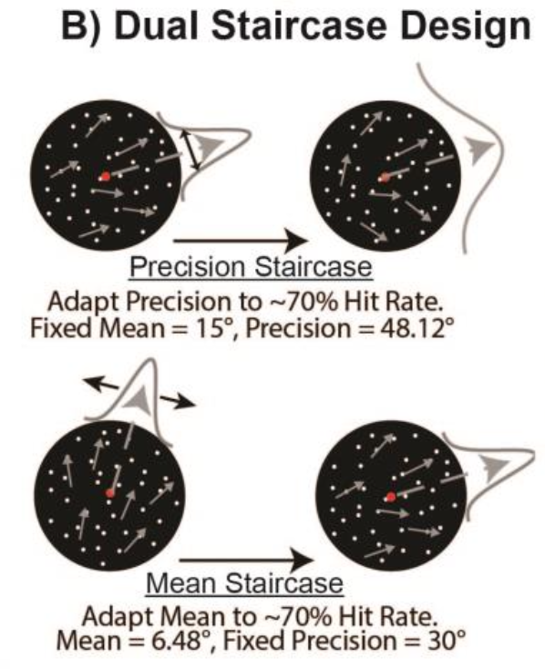
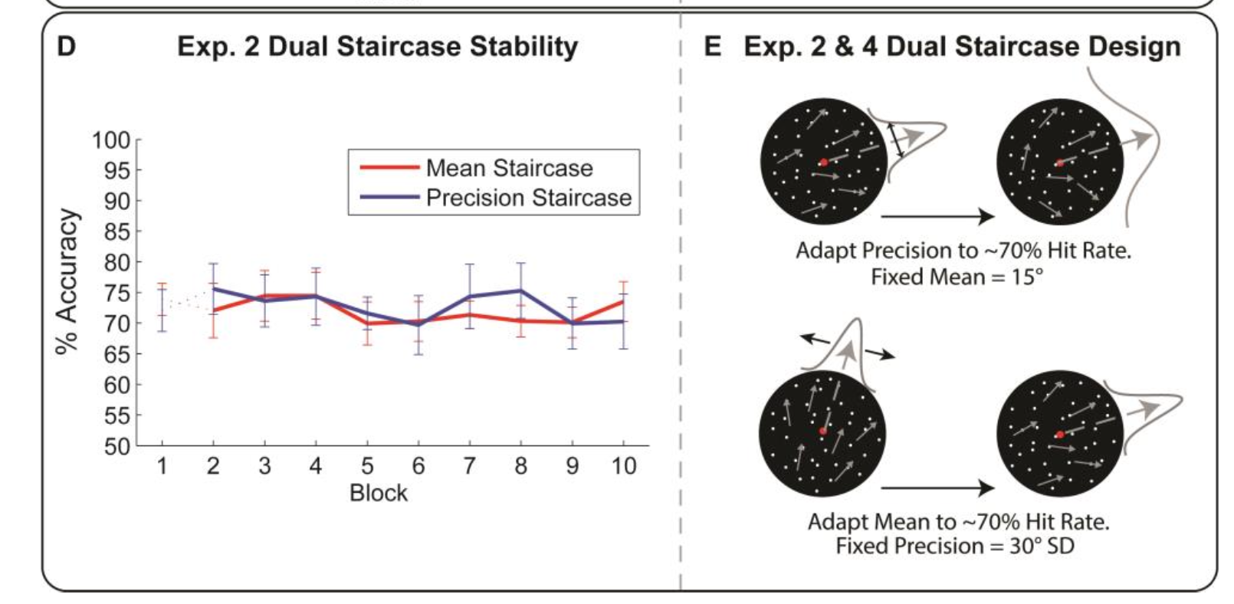
Exp2:Methods
Participants : 24 (12 female, mean age =26y, Range = 18-39)
(20 in analysis)
Two conditions:
Precision Staircase(2-down, 1-up)
low precision, high mean
(μ = 15°, σ = 48.12°)
Mean Staircase(2-down, 1-up)
high precision, low mean
(μ = 6.48°, σ = 30°)
Dependent :
ACC, RT, Confidence
10 Blocks * 40 trials
No main effect and interaction of Blocks
Notes:
同时收的Motor execution和motor imagery任务，拿来做localizer

Slide 18
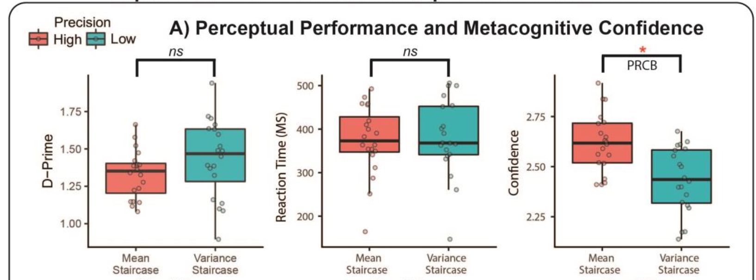
Exp2:Analysis and Result
1.Signal Detection Theoretic Analyses of Perceptual and Metacognitive Performance
2. Paired- sample t-tests
Mean confidence, M-ratio, RT, d’, and perceptual thresholds (average mean or precision) were entered into paired- sample t-tests.
Confidence:
t(19) = 2.68,
p = 0.015,
Cohen’s d = 0.60
No differences in
m-ration
were observed
(p = 0.414)
Notes:
同时收的Motor execution和motor imagery任务，拿来做localizer

Slide 19


Exp2:Analysis and Result
3. Trial-wise Prediction of Confidence
To assess the specific influence of sensory precision on confidence, we again fit a trial-wise multiple regression model to the confidence data.
Here the model was identical to that of experiment 1, with the exception that we did not include the interaction of sensory mean and precision as these were not manipulated in a factorial design and hence where not orthogonal to one another.
For each subject:
Notes:
同时收的Motor execution和motor imagery任务，拿来做localizer

Slide 20
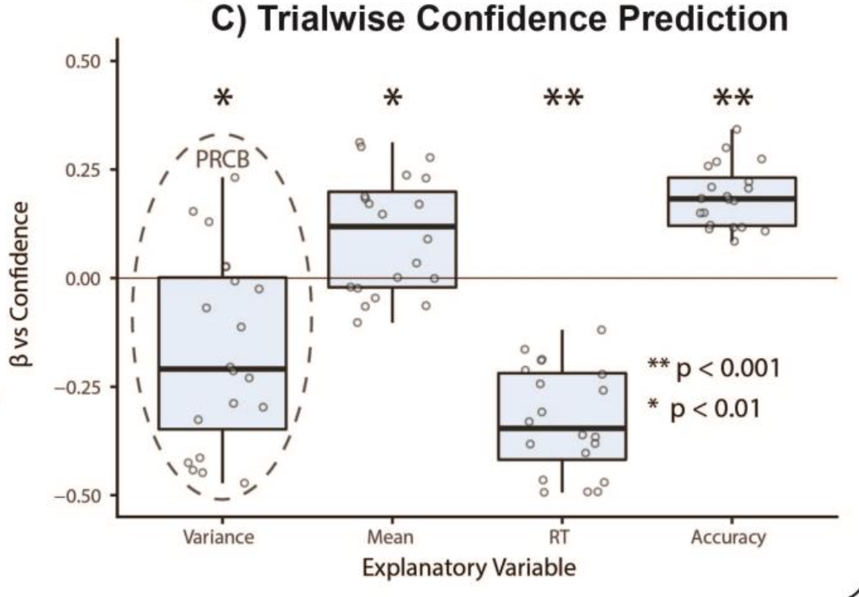
Exp2:Analysis and Result
sensory precision
t(19) = -3.45, p = 0.0027,
mean beta = -0.17
sensory mean
t(19) = 3.34, p = 0.0035
RT
t(19) = -12.02, p < 0.001
Accuracy
t(19) = 11.80, p < 0.001
Notes:
同时收的Motor execution和motor imagery任务，拿来做localizer

Slide 21
Experiment4 = Exp 2 + VBM，探索与PRCBs相关的脑区
Notes:
同时收的Motor execution和motor imagery任务，拿来做localizer

Slide 22
Exp4:Methods
Participants : 49 (28 female, mean age =24y, Range = 18-39)
(44 in analysis)
Two conditions:
Precision Staircase(2-down, 1-up)
low precision, high mean
Mean Staircase(2-down, 1-up)
high precision, low mean
Dependent :
ACC, RT, Confidence
10 Blocks * 40 trials
No main effect and interaction of Blocks
Notes:
同时收的Motor execution和motor imagery任务，拿来做localizer

Slide 23
Exp4:Analysis and Result
1.Signal Detection Theoretic Analyses of Perceptual and Metacognitive Performance
2. Paired- sample t-tests
Behavioural analysis showed that confidence was again significantly reduced for the lower-precision stimuli (t(43) = -5.40, p < 0.001) despite similar perceptual performance.
3. Trial-wise Prediction of Confidence
Our trial-wise regression analysis further replicated the independence of this effect from sensory mean, RT, and accuracy, with a significant negative impact of reduced precision on confidence (mean beta = -0.27, t(43) = -4.58, p < 0.001).
4.VBM
We then used the beta-weight encoding the specific influence of precision on confidence as an index of the confidence bias(PRCBs) in each participant, in a whole-brain multiple regression voxel-based morphometry analysis.
Notes:
同时收的Motor execution和motor imagery任务，拿来做localizer

Slide 24
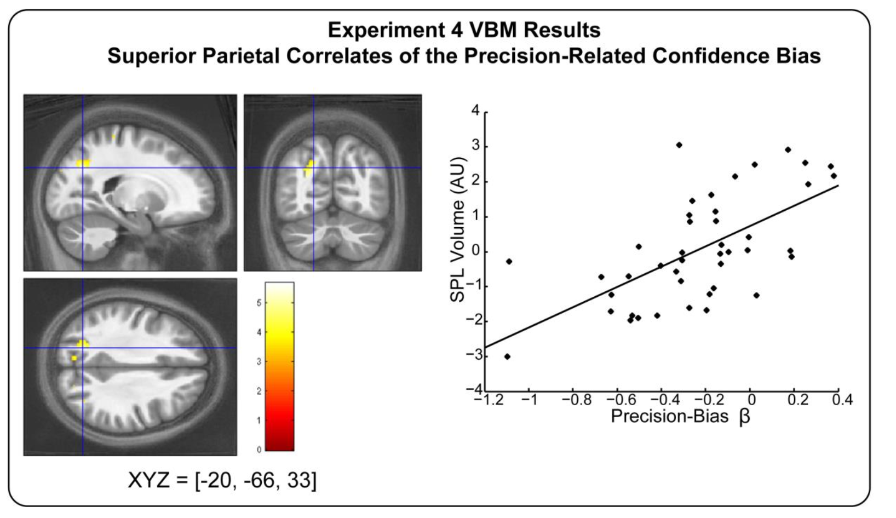
Exp4:Analysis and Result
SPL grey matter volume correlates with individual differences in precision-bias.
Notes:
同时收的Motor execution和motor imagery任务，拿来做localizer

Slide 25
Experiment3——PRCB和瞳孔扩张程度的关系
Notes:
同时收的Motor execution和motor imagery任务，拿来做localizer

Slide 26
Exp3:Methods
In Experiment 3, we adapted our task for pupillometry to assess how task-evoked changes in arousal encode the interaction of sensory precision and confidence.
Experiment 3 (N = 32, 19 females, average age = 24 years, range = 18-38) (28 in analysis)was identical to Experiment 1, with the following exceptions designed to maximize precision of our pupil measurements.
Participants completed 480 trials divided evenly between each staircase condition, with 8 randomized blocks of 60 trials each.
To equate discrimination difficulty, which can have a profound impact on pupil dilation (Kahneman and Beatty, 1966), in two separate 2-down 1-up staircase conditions we continuously adapted mean signal with a fixed precision of either 15 or 25 standard degrees.
This resulted in a low mean, low precision condition (Signal μ =3.29°, SD = 1.35°, Signal Precision σ = 25°) and a high mean, high precision condition (Signal μ = 5.96°, SD = 2.87°, Signal Precision σ = 15°).
Notes:
同时收的Motor execution和motor imagery任务，拿来做localizer

Slide 27
Exp3:Analysis and Result
1.Paired T test and one-way repeated measures ANCOVA
However this approach introduces a strong trial-wise correlation between mean and precision which we sought to account for in our analyses.
In our behavioral analysis, we first assessed whether our procedure equated performance.
Indeed, pairwise t-tests did not reveal any significant differences in mean RT (t(27) = 1.96, p = 0.057) or d’ (t(27) = -0.91, p = 0.37).
In contrast to our previous experiments in which trial-wise mean and precision were de-correlated, here we observed no significant overall effect of stimulus precision on confidence (t(27) = 0.91, p = 0.37), replicating De Gardelle et al (2015).
Notes:
同时收的Motor execution和motor imagery任务，拿来做localizer

Slide 28
Exp3:Analysis and Result
1.Paired T test 、 one-way repeated measures ANCOVA 、Trial-wise Prediction of Confidence
As this effect is confounded by the staircase-induced correlation between sensory mean and precision, we re-analysed the confidence data in a one-way repeated measures ANCOVA (Factor: Precision), while controlling for the difference in median signal orientation between each condition. （HMHP vs LMLP）
This revealed a significant main effect of precision on confidence (F(1, 26) = 8.09, p = 0.009, partial η2 = 0.19) and a precision by orientation difference interaction (F(1,26) = 7.74, p = 0.01, partial η2 = 0.19).
Thus, when accounting for the staircase-induced mean difference, the precision-related bias is again apparent.
This result was further confirmed by our trial-wise regression analysis predicting confidence: low precision again significantly reduced confidence (t(27) = -2.95, p = 0.007) when accounting for stimulus mean, RT, and accuracy.
These results underscore the importance of accounting for both sensory mean and precision when assessing their influence on perceptual confidence.
Notes:
同时收的Motor execution和motor imagery任务，拿来做localizer

Slide 29
Exp3:Analysis and Result
1.Paired T test 、 one-way repeated measures ANCOVA 、Trial-wise Prediction of Confidence
This result (the precision-related bias is again apparent )was further confirmed by our trial-wise regression analysis predicting confidence: low precision again significantly reduced confidence (t(27) = -2.95, p = 0.007) when accounting for stimulus mean, RT, and accuracy. These results underscore the importance of accounting for both sensory mean and precision when assessing their influence on perceptual confidence.
Notes:
同时收的Motor execution和motor imagery任务，拿来做localizer

Slide 30
Exp3:Analysis and Result
1.Paired T test 、 one-way repeated measures ANCOVA 、Trial-wise Prediction of Confidence
2. Pupillary time series
Previous investigations have suggested that arousal contributes to perceptual confidence (Lempert et al., 2015; Hauser et al., 2017a), and that the manipulation of arousal reduces precision-related confidence biases(PRCB) (Allen et al., 2016).
We therefore examined the correlation of sensory precision, confidence, and their interaction with pupil dilation while controlling for sensory mean, RT, and decision accuracy using a cluster-corrected general linear modelling approach .
Notes:
同时收的Motor execution和motor imagery任务，拿来做localizer

Slide 31
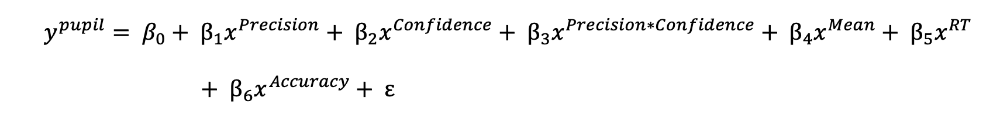
Exp3:Analysis and Result
1.Paired T test 、 one-way repeated measures ANCOVA 、Trial-wise Prediction of Confidence
2. Pupillary time series
Data for the high and low precision condition were epoched according to motion onset, from -1000ms baseline to 4000ms (rating offset).
Pupillary time series were analysed using a trial-level general linear modelling approach.
To do so, each trial was first baseline corrected for the pre-stimulus interval.
Design matrices were then constructed with explanatory regressors encoding the main effects of stimulus precision, confidence, and their interaction.
We also modelled stimulus mean, accuracy, and RT for each trial, to control for possible confounding effects of perceptual difficulty.
Notes:
同时收的Motor execution和motor imagery任务，拿来做localizer

Slide 32
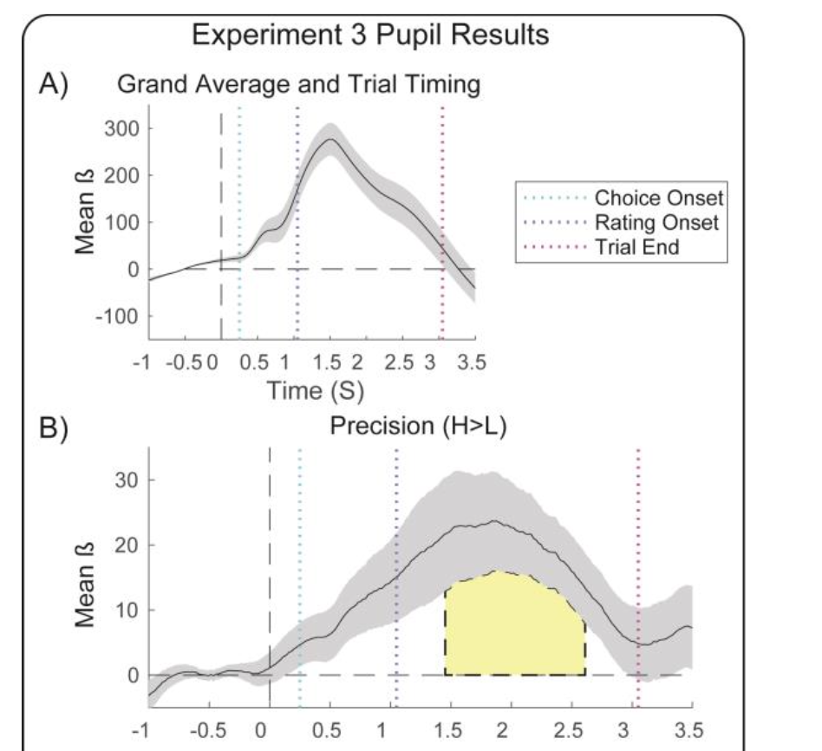
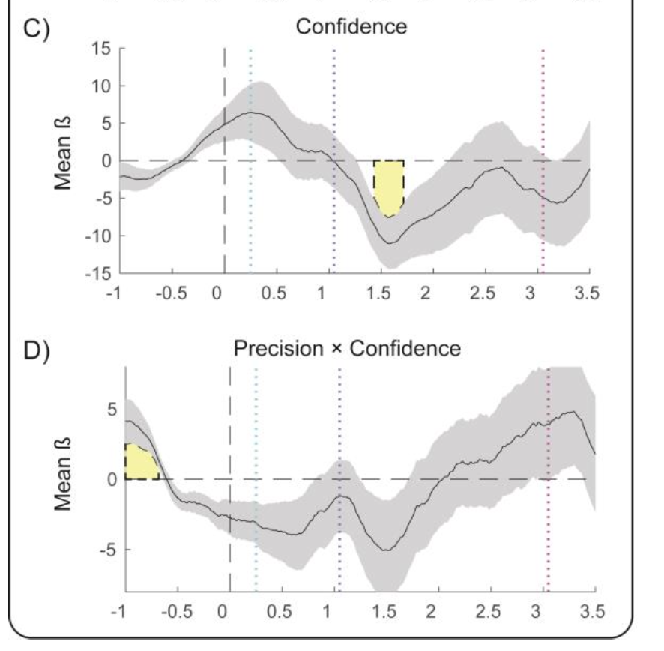
Exp3:Analysis and Result
t(22) = -11.02, pCluster = 0.048, 1.43~1.72s
瞳孔扩张(唤醒降低)-> PRCB 提高
PRCB
t(22) = 23.69, pCluster = 0.003, 1.45~2.61s
t(22) = 4.82, pCluster = 0.037, -1~-0.68s
Notes:
同时收的Motor execution和motor imagery任务，拿来做localizer

Slide 33
Conclusion
Our study provides strong confirmation of a performance-independent confidence bias in response to fluctuations in perceptual precision.
This bias is found above and beyond the impact of precision on task performance, suggesting that parallel and/or top-down architectures may provide a better model of confidence than standard feed-forward models.
Further, this bias is linked to fluctuations in baseline arousal and individual differences in cortical neuroanatomy. As many psychiatric illnesses involve confidence biases or metacognitive deficits (Bliksted et al., 2017; Hauser et al., 2017b; Rouault et al., 2018), a PRCB may be a useful computational marker for disordered self-monitoring in diseases such as psychosis(精神病), autism(孤独症), and OCD(强迫症).
Notes:
同时收的Motor execution和motor imagery任务，拿来做localizer

Slide 34
Discussion
What mechanism underlies the precision-related bias?
Although most early models of confidence emphasized a role for serial, feed-forward processing , growing evidence of confidence-accuracy dissociations (Fleming et al., 2015; Allen et al., 2016) cast doubt on models which specify that the computation of confidence is wholly subsumed by the first-order decision variables governing choice accuracy itself.
Instead our results may be better explained by either a parallel processing architecture and/or a top-down predictive processing scheme (see e.g., Fleming and Daw, 2017).
Notes:
同时收的Motor execution和motor imagery任务，拿来做localizer

Slide 35
Discussion
What mechanism underlies the precision-related bias?
As an example of the former, it is possible that the visual system has evolved to attribute extra salience to fluctuations in perceptual precision.
In this case, confidence may arise both from a serial architecture in which prefrontal neurons monitor the variability of parietal evidence accumulation to provide an initial estimate of confidence (Kiani and Shadlen, 2009; Maniscalco and Lau, 2016), and a parallel pathway specifically signalling perceptual salience.
This is a potentially compelling explanation of our results: evoked changes in arousal are directly linked to enhanced perceptual salience (Hochstein and Ahissar, 2002) and are also known to change the gain or non-linearity of cortical responses (Simoncini et al., 2012; Eldar et al., 2013).
Thus, changes in baseline arousal may simultaneously alter perceptual salience and increase the sensitivity of confidence-related brain areas to changes in perceptual precision.
Notes:
同时收的Motor execution和motor imagery任务，拿来做localizer

Slide 36
Discussion
What mechanism underlies the precision-related bias?
Alternatively, predictive-processing accounts of metacognition posit that confidence depends upon the mismatch between an expected level of perceptual precision and actual incoming sensory precision (i.e., a confidence prediction error) (Fetsch et al., 2015; Allen et al., 2016; Allen and Friston, 2016; Fleming and Daw, 2017).
As changes in baseline arousal are linked to increased levels of neuronal noise and poorer task performance (Aston-Jones and Cohen, 2005; Mather et al., 2015), such changes may alter top-down estimates of expected precision and hence titrate the influence of sensory precision on confidence.
Disentangling these (speculative) suggestions will require tasks that manipulate both expected and sensory precision in conjunction with causal manipulations of arousal; here we can only demonstrate that changes in sensory precision evoke a performance-independent bias, supporting these and other non-serial metacognitive architectures.
Notes:
同时收的Motor execution和motor imagery任务，拿来做localizer

Slide 37
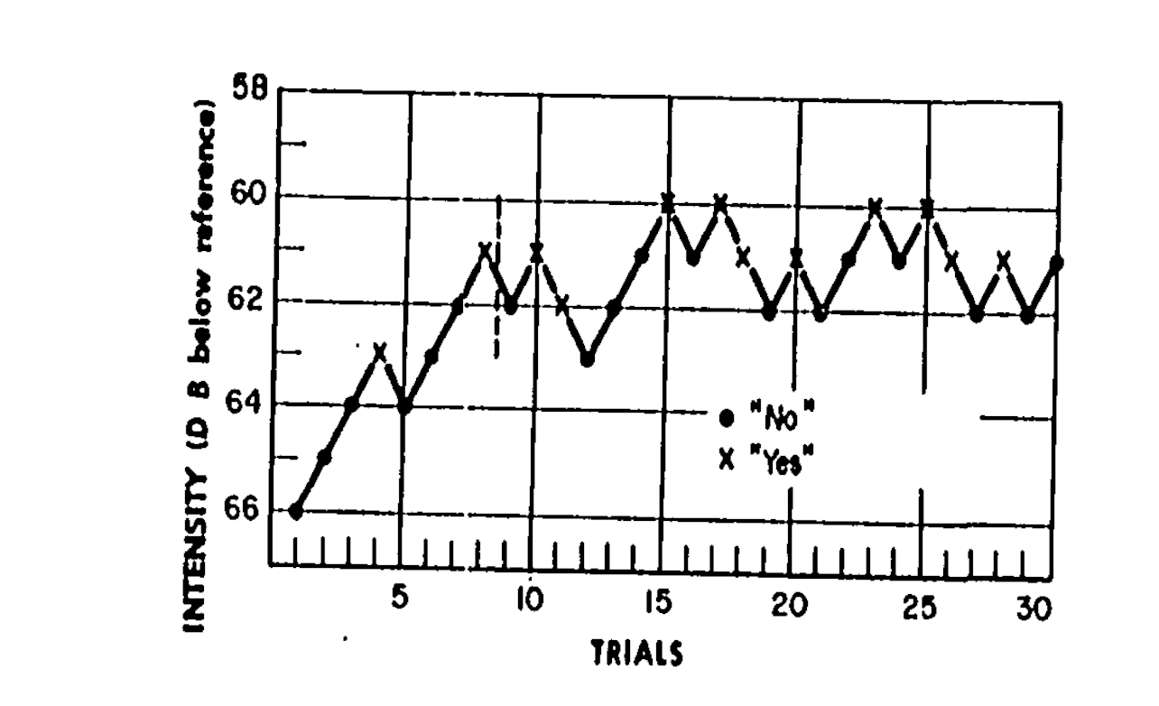
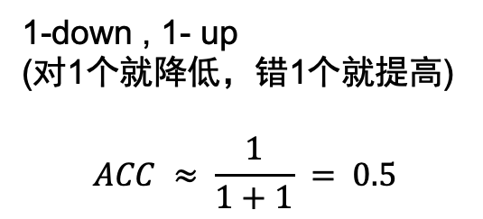
Staircase阶梯法——用来确定不同准确率下的感觉阈值
1-down , 1- up
(对1个就降低，错1个就提高)
$$ACC ≈ \frac{1}{1+1} = 0.5$$
Notes:
同时收的Motor execution和motor imagery任务，拿来做localizer

Slide 38
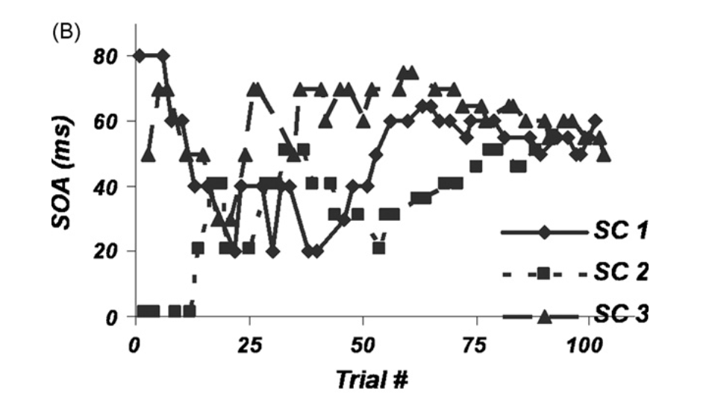
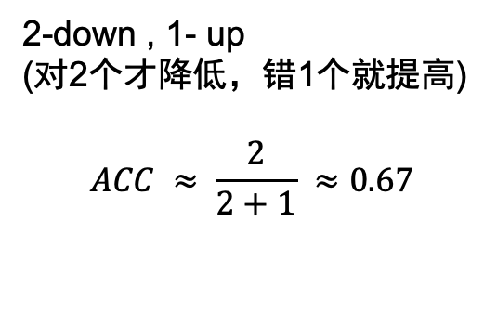
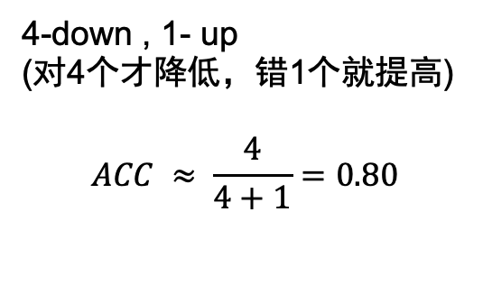
Staircase阶梯法——用来确定不同准确率下的感觉阈值
2-down , 1- up
(对2个才降低，错1个就提高)
$$ACC ≈ \frac{2}{2+1} ≈0.67$$
4-down , 1- up
(对4个才降低，错1个就提高)
$$ACC ≈ \frac{4}{4+1}=0.80$$
Back
Notes:
同时收的Motor execution和motor imagery任务，拿来做localizer

Slide 39
Exp3:Analysis and Result
1.Paired T test 、 one-way repeated measures ANCOVA 、Trial-wise Prediction of Confidence
2. Pupillary time series
3. Hierarchical Drift Diffusion Modelling of Perceptual Decision Making
We further explored the relationship between baseline arousal, sensory precision, and perceptual decision-making in our task using a drift diffusion model (DDM) to assess the impact of these variables on decision-related mechanisms. DDMs model the relationship between response accuracy and reaction time as a drifting accumulator that undergoes a biased random walk towards one or other choice boundary (e.g., left vs rightward motion) (Fig. 5A). The model thus captures a putative evidence accumulation process underpinning perceptual decision-making (Ratcliff and McKoon, 2007; Kiani and Shadlen, 2009). Notably, evidence accumulation signals recorded from the parietal cortex of macaques have been shown to relate closely to perceptual confidence (Kiani and Shadlen, 2009; Kiani et al., 2014).
Notes:
同时收的Motor execution和motor imagery任务，拿来做localizer

Slide 40
Exp3:Analysis and Result
1.Paired T test 、 one-way repeated measures ANCOVA 、Trial-wise Prediction of Confidence
2. Pupillary time series
3. Hierarchical Drift Diffusion Modelling of Perceptual Decision Making
To do so, we used a hierarchical drift diffusion model (HDDM) to assess the impact of pre- trial arousal and sensory precision on different model parameters. Following previous investigations (de Gee et al., 2017), ‘low vs ’high’ baseline arousal was parameterized by binning mean pre-trial dilation (-1000 to -500ms pre-trial interval) into the lowest and highest 40% of trials (Fig. 5B), separately for each participant. We then modelled the effects of sensory precision and arousal on decision making using an HDDM. The HDDM uses a Monte-Carlo Markov Chain (MCMC) method to fit a Bayesian mixed-effects implementation of the DDM, pooling over fixed and random effects to provide more robust parameter estimates. Using standard settings in the HDDM toolbox, we specified models with the following free parameters: the drift rate v denotes the speed of evidence accumulation, decision threshold a models the information threshold required to make a decision, and the non-decision time t captures the decision-independent processing time
Notes:
同时收的Motor execution和motor imagery任务，拿来做localizer

Slide 41
Exp3:Analysis and Result
1.Paired T test 、 one-way repeated measures ANCOVA 、Trial-wise Prediction of Confidence
2. Pupillary time series
3. Hierarchical Drift Diffusion Modelling of Perceptual Decision Making
Convergent evidence suggests that confidence depends on a second-order ‘read-out’ of evidence accumulation (Moran et al., 2015; Fleming and Daw, 2017); a confidence bias may thus emerge if exogenous (i.e., stimulus precision) or endogenous (i.e., arousal) factors influence underlying evidence accumulation. Because both arousal and sensory precision can be expected to increase the gain or excitability of motion-sensitive neuronal populations (Cheadle et al., 2014; Mather et al., 2015; Vinck et al., 2015), which is in turn related to evidence accumulation itself (Aston-Jones and Cohen, 2005; Eldar et al., 2013; Hauser et al., 2016), we hypothesized that the interaction of these factors covary with evidence accumulation (v) and that this super-additive effect may explain the over-representation of precision in confidence. To test this hypothesis, we compared models in which precision, baseline arousal, and their interaction could covary with either a (M2), t (M3), or v (M4).
Notes:
同时收的Motor execution和motor imagery任务，拿来做localizer

Slide 42
Exp3:Analysis and Result
1.Paired T test 、 one-way repeated measures ANCOVA 、Trial-wise Prediction of Confidence
2. Pupillary time series
3. Hierarchical Drift Diffusion Modelling of Perceptual Decision Making
Crucially, because we controlled for task difficulty by adjusting signal strength (mean orientation), we used a regression-based approach that further allowed v to covary with signal strength across every trial. This enabled us to estimate the independent effect of sensory precision on different decision-related computations, and follows from previous studies demonstrating that stimulus strength directly modulates evidence accumulation (Hauser et al., 2017b). Further, we also included a ‘baseline model’ in which only v could covary with signal strength (M1). Models were compared using deviance information criterion (DIC); the individual posterior parameters of the best-fitting (i.e., with the best trade off of complexity to accuracy) model where then assessed for statistical significance. All models were fit with 500 burn-in samples and 10,000 total samples; inspection of posterior model parameters revealed good model convergence for all models using these parameters. See Table 1 for model comparison results.
Notes:
同时收的Motor execution和motor imagery任务，拿来做localizer

Slide 43
Exp3:Analysis and Result
1.Paired T test 、 one-way repeated measures ANCOVA 、Trial-wise Prediction of Confidence
2. Pupillary time series
3. Hierarchical Drift Diffusion Modelling of Perceptual Decision Making
We found that the best-fitting model was one in which stimulus precision, baseline arousal, and their interaction covaried with v (see Table 1). Inspection of the posterior parameters of this model (Fig. 5C) revealed that both sensory precision (p < 0.001) and arousal (p = 0.004) significantly increased evidence accumulation (drift rate). Replicating previous investigations, stimulus mean also increased drift rate (Hauser et al., 2017b); however, in contrast to our hypothesis the arousal by precision interaction was not significant (p > 0.05). These results support previous investigations that link arousal to boosts in perceptual evidence accumulation (Lufityanto et al., 2016), and indicate that sensory precision and arousal both independently contribute to evidence accumulation but do not interact.
Notes:
同时收的Motor execution和motor imagery任务，拿来做localizer

Slide 44
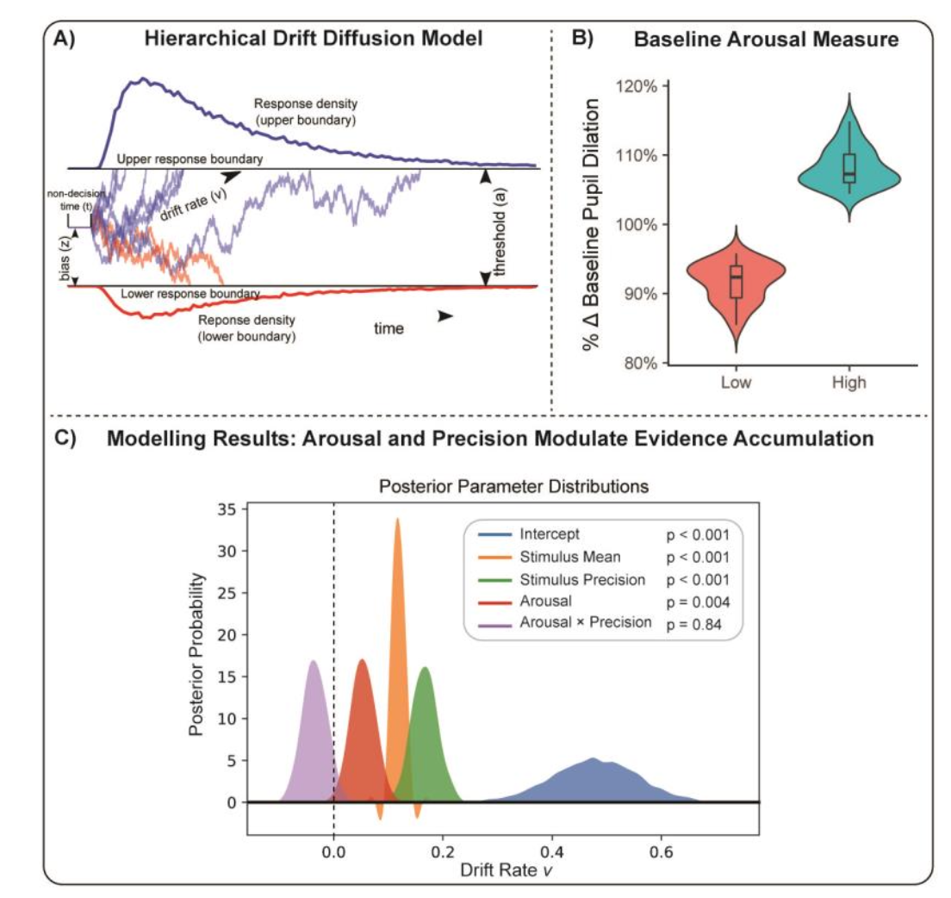
Exp3:Analysis and Result
Notes:
同时收的Motor execution和motor imagery任务，拿来做localizer

Slide 45
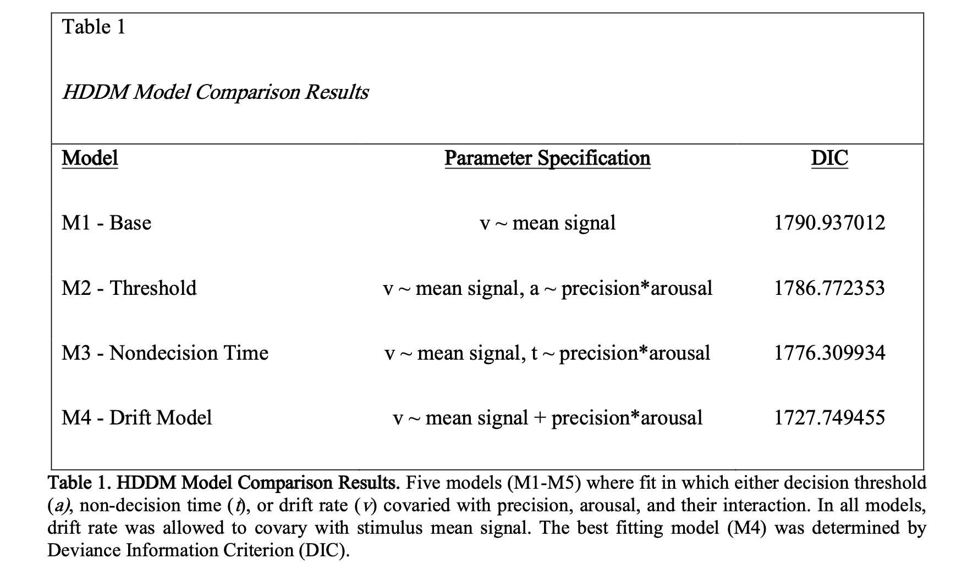
Exp3:Analysis and Result
Notes:
同时收的Motor execution和motor imagery任务，拿来做localizer

Slide 46
谢谢大家
Notes:
同时收的Motor execution和motor imagery任务，拿来做localizer

